Slide 1


Gender Detection Face
Group12
Dingling Ge
Zefan Feng

Slide 2


CONTENTS
Introduction
Methodology
Dataset
Realization
Experiment, Results and Analysis
Conclusion

Slide 3


1.0 Introduction
Human face contains rich information, such as gender, age, race, expression, etc., and the application of facial image has attracted wide attention. Among them, gender is the most basic information you need to know to classify humans. Generally, humans can intuitively and easily judge a person ’s gender by using human eyes, but it is not easy for a computer to achieve the same function.
In this project, we are trying to approach a precise binary classification between biological males and females.
This project supports the following objectives:
Choose an algorithm to implement gender detection (CNN and ANN?)
Optimize performance through parallelism (multi-CPU)
Experimental support
Analysis
conclusion

Slide 4


2.0 Methodology
2.1 Problem Analysis
Image classification problem, which is the task of assigning a label to the input image from a fixed set of classifications. This is one of the core problems of computer vision. In this project, the image classification model requires a single image and assigns the probability to 2 labels {man, woman}.
Our task is to turn this quarter number into a single label, such as "man". For the convenience of calculation, we can convert the white RGB three-channel image into a grayscale image for processing, and finally predict the classification to which the picture belongs and compare it with the original labeled label to see the performance. So, in general, this is a binary classification problem.
Compared to the CSV dataset, the features of the picture file are far Much larger than the CSV dataset. At the same time, the size of the picture will also affect the number of features. The larger the picture size, the more features will increase. Therefore, the image dataset usually takes more time to train. But we want to increase the speed of training and get results in less time, so the parallel is our primary choice to improve performance.

Slide 5
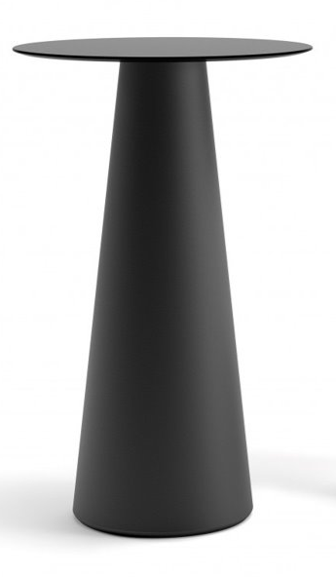



2.0 Methodology
2.2 Algorithms and software libraries
ANN CNN
TensorFlow Keras OpenCV
OpenMP (wrapped by TensorFlow)

Slide 6

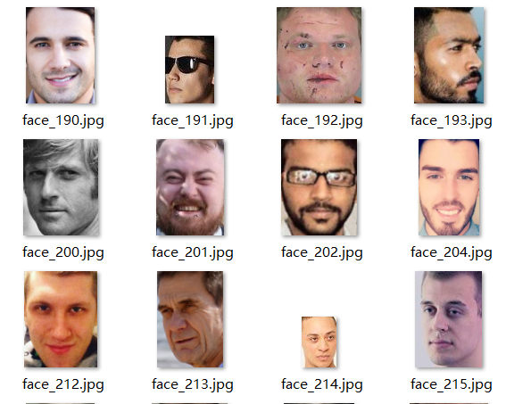
3.0 Dataset
This dataset contains 2280 cropped faces (1140 male and 1140 female), and it is the dataset of Kaggle labeled with face gender recognition in 2018, which collected from the color face images of celebrities from the Internet in Europe and U.S, and the dataset have different factors such as illumination, wearing glasses, the head part.

Slide 7
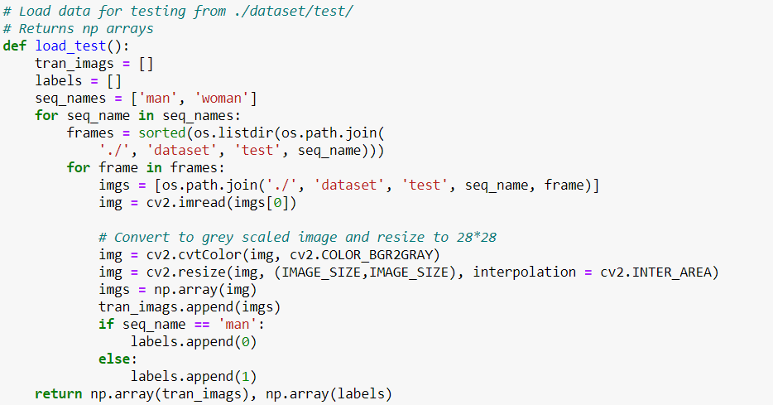
4.0 Realization
4.1 load data
Using opencv to read data for testing from ./dataset/test/, and returns np arrays, then convert the original image to grey scaled image and resize to 28*28. The same to the training dataset.

Slide 8
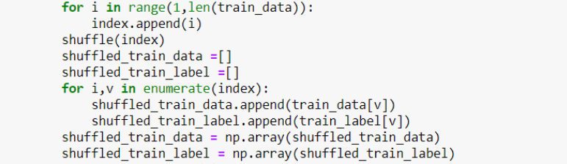
4.0 Realization
4.2 Shuffle data
Shuffle data every time to get different train/validate dataset, because the assumptions and data requirements of machine learning are to satisfy independent and identical distribution. It can prevent model jitter during training, which is conducive to the robustness of the model, and prevent overfitting and make the model learn more correct features, and make the data distribution of training set, validation set and test set balanced.

Slide 9
4.0 Realization
4.3 Construct ANN model and training
We first initialize the ANN, adding the input layer and the first hidden layer, and adding the second layer and output layer. Then compile the ANN model.
Then, we fit the ANN to the training set, train with 15 epochs, which leads to a nearly converged result. The validation rate is set to 20% of the total training dataset.

Slide 10
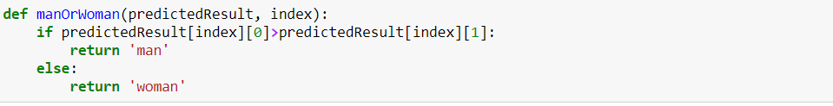
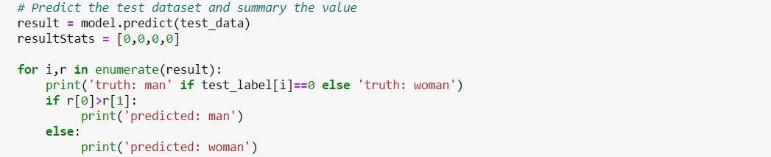
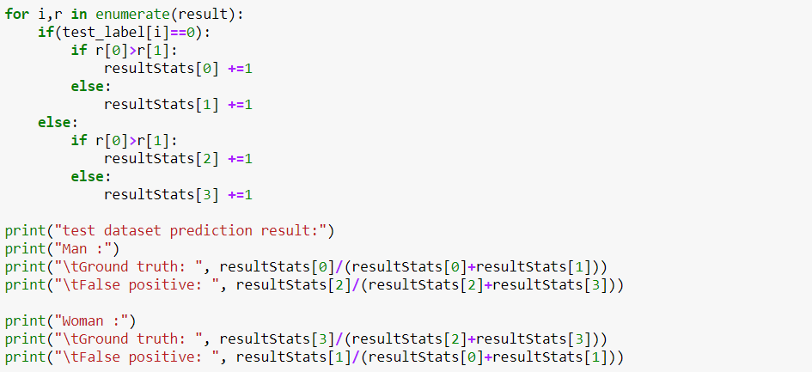
4.0 Realization
4.4 Predict the gender and Evaluate the results by ANN
Define a manOrWoman function to better express the results. For evaluation, we use cross entropy and accuracy to see training performance, and Ground truth and False positive to see the predicted performance. The Specific Analysis of the model and Results will be explained in the later part.

Slide 11
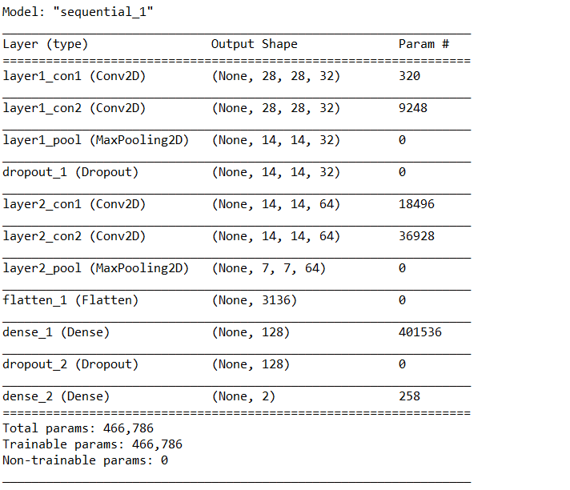
4.0 Realization
4.5 Construct CNN model and training
Based on the CNN structure definition, we construct a CNN model :

Slide 12
4.0 Realization
4.6 Predict the gender and Evaluate the results by CNN
Coding of this part is similar to the ANN process, we will give the details and results for the specific analysis of the model in the later part
4.7 Parallelism
Based on the Tensorflow /compiler /xla /service /backend.h defined, Notice that the parameter intra_op_parallelism_threads redefines the size of the IntraOpThreadPool, which is a structure consisting of a Tensorflow thread pool and a pointer of eigen thread pool devices. Through this we can see that IntraOpThreadPool actually defines the quantity of CPU eigen computation devices. It then works as a member of OpKernel to participate in the calculation.
So, We first control how many threads Tensorflow uses, and set function to print time, then Initial tensorflow session with indicated threads count, and set start time and end time to calculate the run time. Change the threads, we can see the time changes by using multi CPU.

Slide 13

5.0 Experiment, results and Analysis
5.1 Performance of different sizes
5.1.1 Try 28*28
5.1.1.1 ANN vs CNN of training performance
5.1.1.2 ANN vs CNN of test predict performance
5.1.2 Try 100*100
5.1.2.1 ANN vs CNN of training performance
5.1.2.2 ANN vs CNN of test predict performance
5.2 Performance of different Threads based on CNN model
5.2.1 Change threads based on 28*28
5.2.2 Change threads based on 100*100

Slide 14
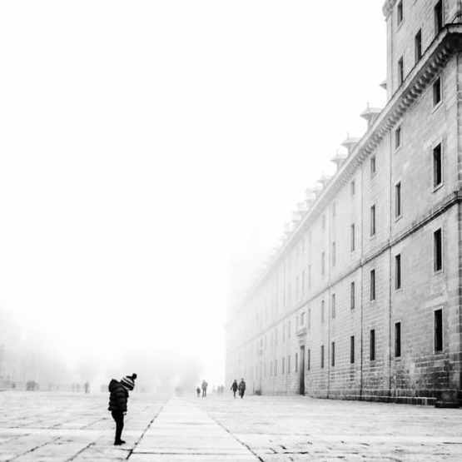
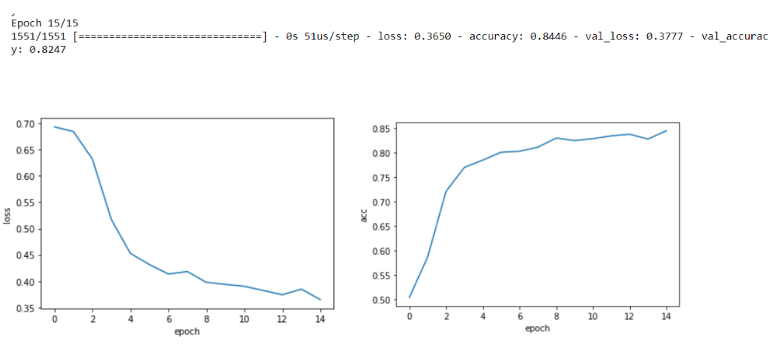
5.0 Experiment, Results and Analysis
5.1 Performance of different sizes
5.1.1 Try 28*28
5.1.1.1 ANN vs CNN of training performance:
ANN:

Slide 15
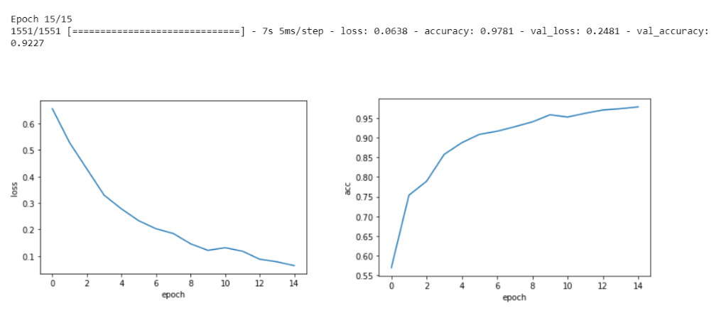
5.0 Experiment, Results and Analysis
5.1 Performance of different sizes
5.1.1 Try 28*28
5.1.1.1 ANN vs CNN of training performance:
CNN:

Slide 16
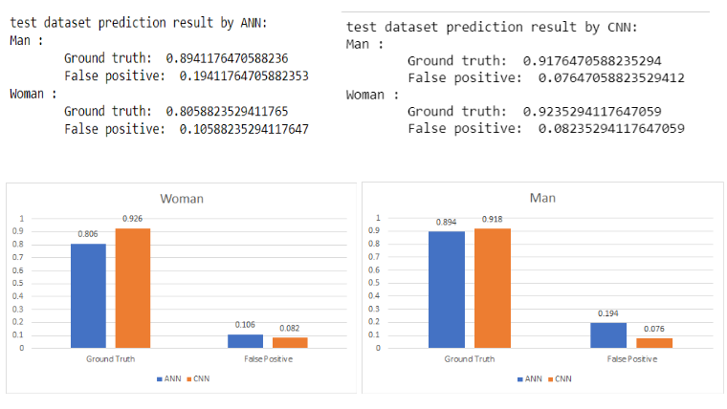
5.0 Experiment, Results and Analysis
5.1 Performance of different sizes
5.1.1 Try 28*28
5.1.1.2 ANN vs CNN of Test predict performance

Slide 17
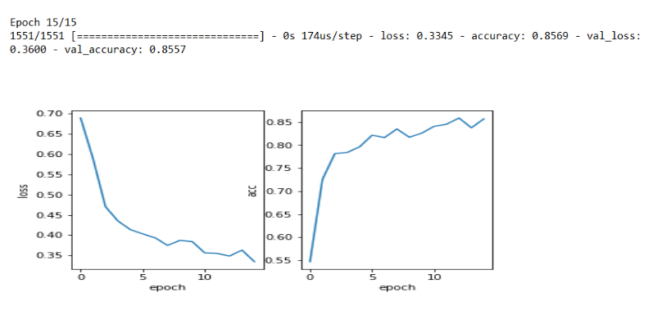
5.0 Experiment, Results and Analysis
5.1 Performance of different sizes
5.1.2Try 100*100
5.1.2.1 ANN vs CNN of training performance:
ANN:

Slide 18
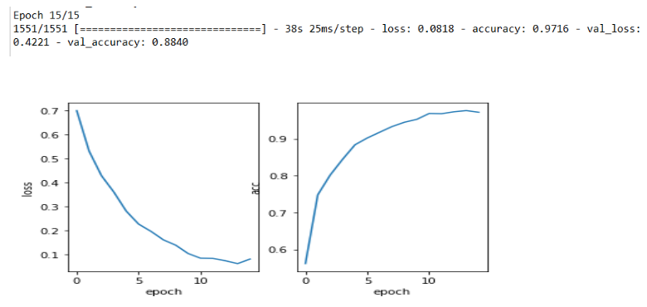
5.0 Experiment, Results and Analysis
5.1 Performance of different sizes
5.1.1 Try 100*100
5.1.2.1 ANN vs CNN of training performance:
CNN:

Slide 19
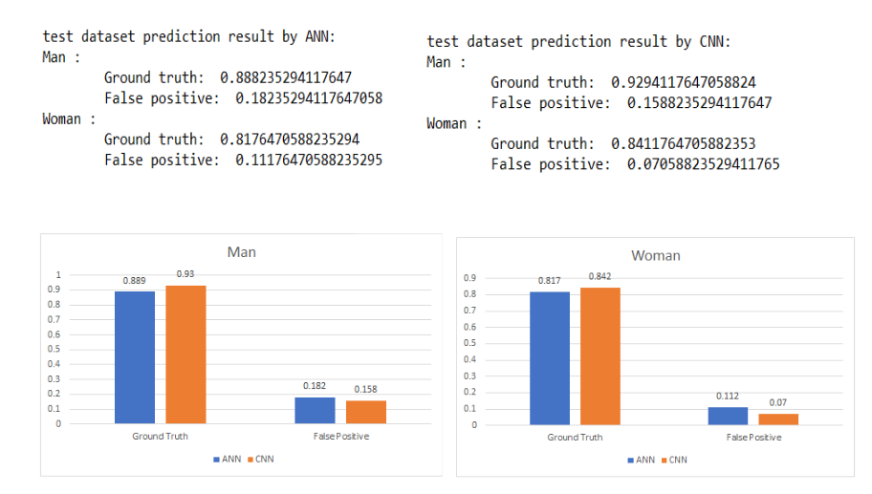
5.0 Experiment, Results and Analysis
5.1 Performance of different sizes
5.1.2Try 100*100
5.1.2.2 ANN vs CNN of Test predict performance

Slide 20

CHOOSE CNN

Slide 21
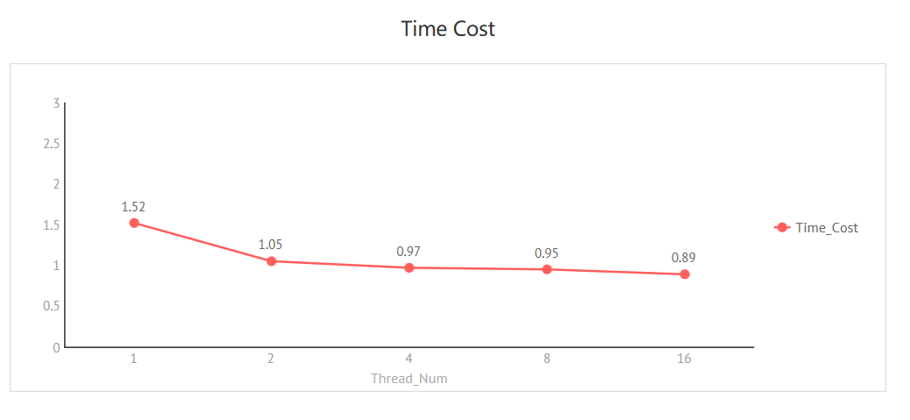
5.0 Experiment, Results and Analysis
5.2 Performance of different Threads based on CNN model
5.2.1 Change threads based on 28*28
Try different Thread Number with 1,2,4,8,16, and we can see the result of speeding up as the following:

Slide 22
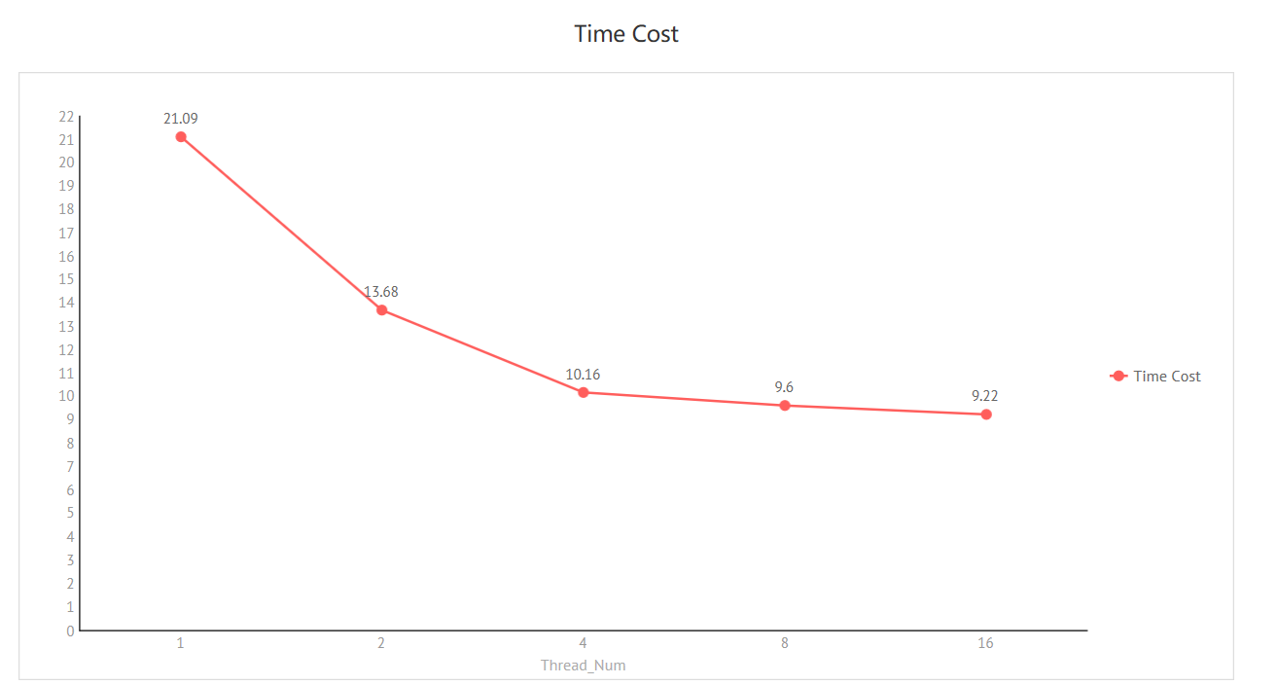
5.0 Experiment, Results and Analysis
5.2 Performance of different Threads based on CNN model
5.2.2 Change threads based on 100*100
By Increasing the size of the images, we can see a more obvious speed increase.

Slide 23
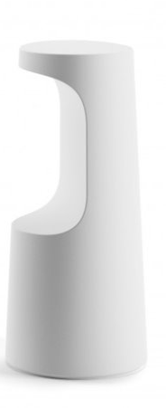
6.0 Conclusion
In this project, we mainly use the ANN and CNN for gender detection of the face image. We resize the image into different sizes to do experiments and found that CNN has better performance on image gender classification task--CNN on Man's ground truth is 0.918 and false positive is 0.076, on Woman's ground truth is 0.924 and false positive is 0.082 on the setting of 28 * 28 size of the image data, which means a good performance. At the same time, we processed it in parallel to speed up the process. Moreover, within a reasonable range, the more input pixels (the larger the size), the more optimizations the parallel has.
According to the above analysis and results, we can conclude that in the field of image classification, convolution neural network performance(CNN) has better performance, whose accuracy can reach to 90% plus, and is more efficient than traditional machine learning algorithms and simple neural network algorithms. The layer structure of convolution neural network(CNN) , is like a combination of the feature engineering and classifier , so the convolution neural network (CNN) rather than extract the data feature in another process, the network will automatically extract the main features in the training of the network.
In future tasks, this model wouldn't be limited to gender detection (which is only a 2-category task), but would be considered for species classification (multi-category task) or speech recognition task and has a good performance based on the characteristics of convolutional neural network(CNN). In further experiments, exponential attenuation learning rate is also considered to optimize the network for better performance.

Slide 24

Thank you!

